Slide 1
5G NR SRS (Sounding Reference Signal) for positioning

Slide 2
Contents
5G Numerology and Resource grid
SRS determination and configuration
SRS Sequence generation
MATLAB implementation

Slide 3
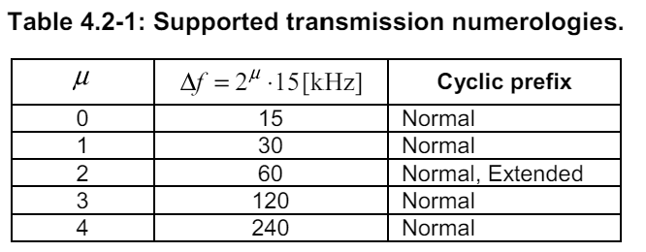
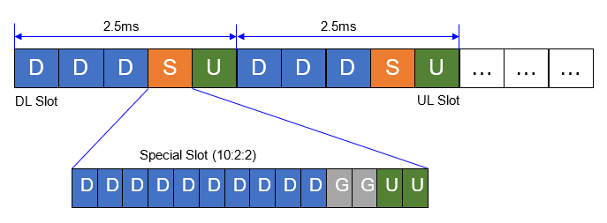
Numerology
For the simplification (and most common 5G NR scenario on C-Band) let’s follow
μ = 1: subcarrierSpacing = 30 kHz and cyclicPrefix = Normal.
100 MHz bandwidth
TDD-UL-DL-slot Configuration: DDDSU 10:2:2
Table 4.2-1: Supported transmission numerologies.
Physical channels and modulation
(3GPP TS 38.211 version 16.2.0 Release 16)

Slide 4
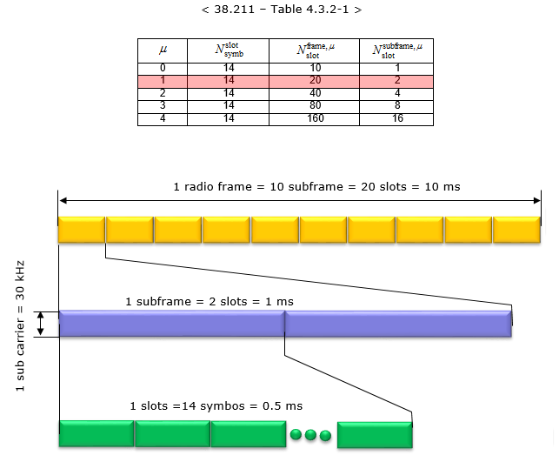
Numerology
Frame duration = 10 ms = 10 SubFrames
SubFrame duration = 1 ms = 2 Slots.
Half-frame 0 consisting of subframes 0 – 4 and half-frame 1 consisting of subframes 5 – 9
Slot = 0.5 ms = 14 OFDM Symbols
Symbol length = 35.68 μs = Tdata + Tcp = 33.33 μs + 2.34 μs
T_{data} = 1/SCS; T_{cp} = 144/2048* Tdata
Cyclic Prefix (CP) – for Sybol 0 or 14 = 2.86 μs. For rest = 2.34 μs
Uplink frame shall start before the start of the corresponding downlink frame on Timing Advance (TA). Details in [38.133].
https://www.sharetechnote.com/html/5G/5G_FrameStructure.html

Slide 5
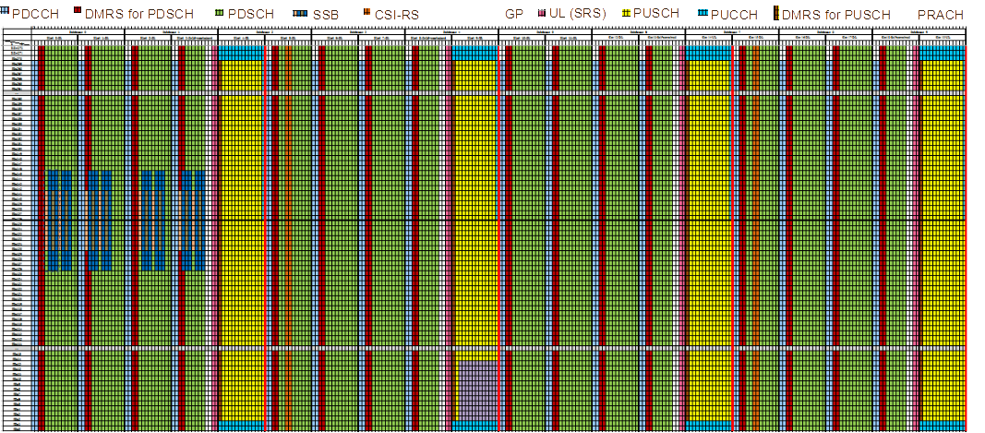
Time-Frequency Domain Distribution

Slide 6
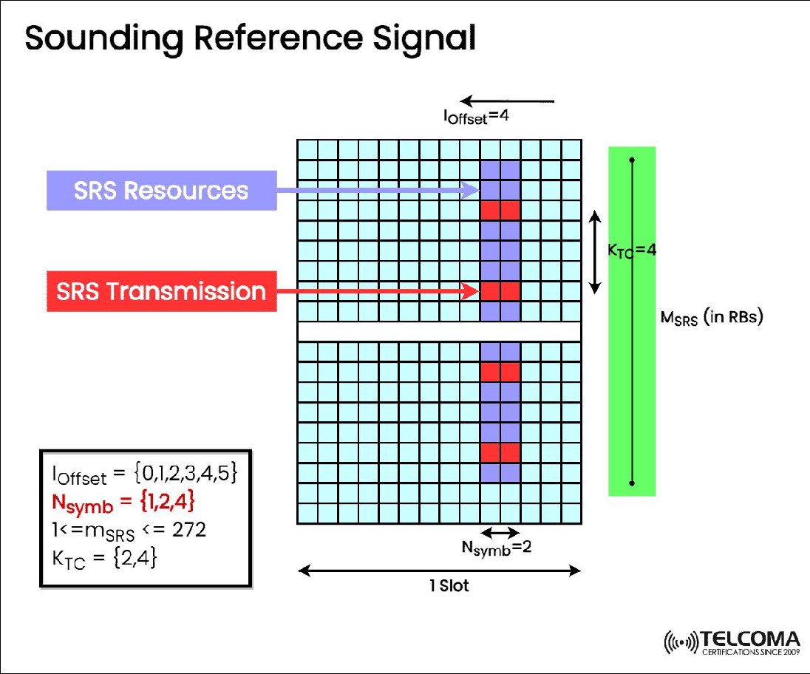
SRS determination and configuration
srs-ConfigIndex tells UE of the periodicity of SRS transmission and the period can be 2,5,10,20,40,80,160,320 ms)
Transmission can occupy up to 272 RBs (100 MHz) in the frequency domain, but an individual UE does not transmit the SRS on every subcarrier but select specific SCs based on transmission comb type(TC).
SRS Transmission can occupy 1, 2, or 4 symbols in the time domain;
Always configured as UE Specific only
Not so much info. Two takeaways:
SRS – is considered for positioning by 3GPP
Main advantage – more OFDM symbols in time domain
SRS-PosResourceSet-r16 – new!
The UE may be configured by the higher layer parameter resourceMapping in SRS-Resource with an SRS resource occupying Ns∈{1,2,4} adjacent OFDM symbols within the last 6 symbols of the slot, or at any symbol location within the slot if resourceMapping-r16 is provided subject to UE capability, where all antenna ports of the SRS resources are mapped to each symbol of the resource. When the SRS is configured with the higher layer parameter SRS-PosResourceSet the higher layer parameter resourceMapping in SRS-PosResource with an SRS resource occupying Ns∈{1,2,4,8,12} adjacent symbols anywhere within the slot.
US20220256519A1 - Sensing in wireless communications system - Google Patents

Slide 7
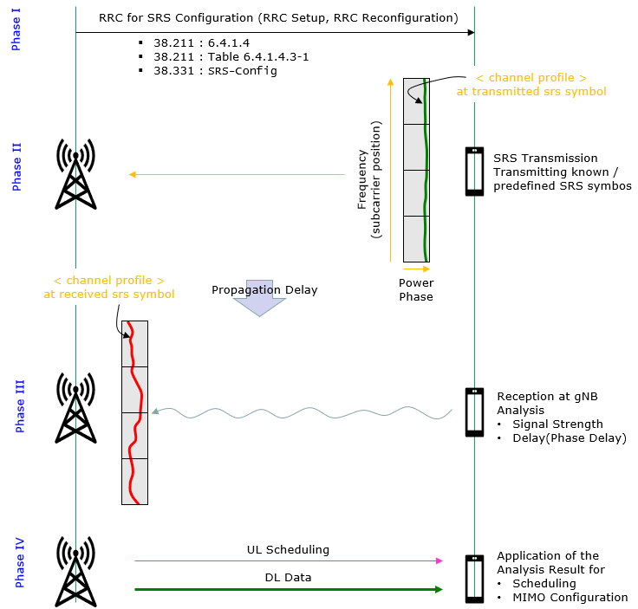
SRS determination and configuration
Phase I - RRC Configuration for SRS
This is the phase where gNB determines about SRS configuration (e.g, SRS physical resources, usage, report period timing etc) and notifies the configuration to UE via RRC messages (e.g, RRCSetup, RRCReconfiguration).
Phase II - SRS transmission from UE
In this phase, the UE transmits the SRS, which is a predefined signal with known characteristics, at a specific time and frequency. The SRS configuration is provided to the UE by the gNB, and it may vary depending on the cell's conditions and traffic requirements. The UE sends the SRS periodically or aperiodically, as instructed by the gNB, on the uplink (UL) channel.
Phase III - SRS reception at gNB and Analysis
…..
…..
https://www.sharetechnote.com/html/5G/5G_SRS.html

Slide 8
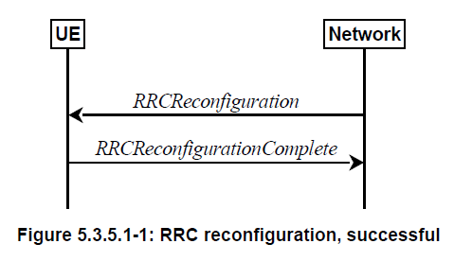
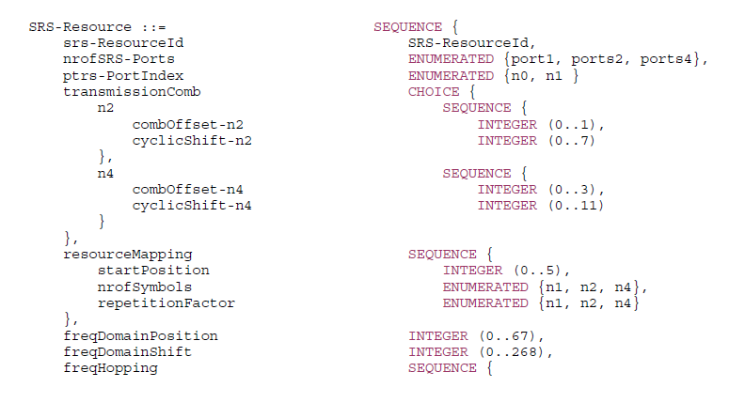
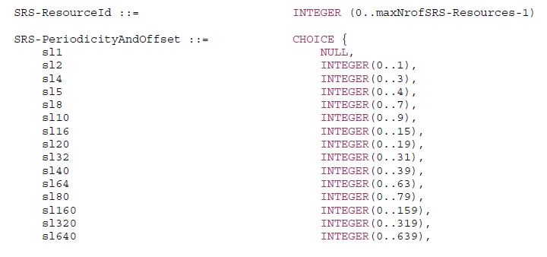
SRS configuration: how UE is informed
RRC Configuration (SIB 1, RRCSetup, RRCReconfiguration) messages contain parameters about SRS.
5G NR Radio Resource Control (RRC) protocol Information Elements (IEs)
For a UE in RRC_CONNECTED, the network can provide system information through dedicated signalling
using the RRCReconfiguration message
SRS-Resource IE
SRS-Config
SRS-ResourceSet & SRS-PosResourceSet-r16
The SRS-Config IE is used to configure sounding reference signal transmissions. The configuration defines a list of SRS-Resources and a list of SRS-ResourceSets. Each resource set defines a set of SRS-Resources. The network triggers the transmission of the set of SRS-Resources using a configured aperiodicSRS-ResourceTrigger (L1 DCI).
5G; NR; Radio Resource Control (RRC);
Protocol specification (3GPP TS 38.331 version 15.3.0 Release 15);
5G; NR; Physical layer procedures for data (3GPP TS 38.214 version 16.2.0 Release 16)
Section: 6.2.1.4 UE sounding procedure for positioning purposes

Slide 9
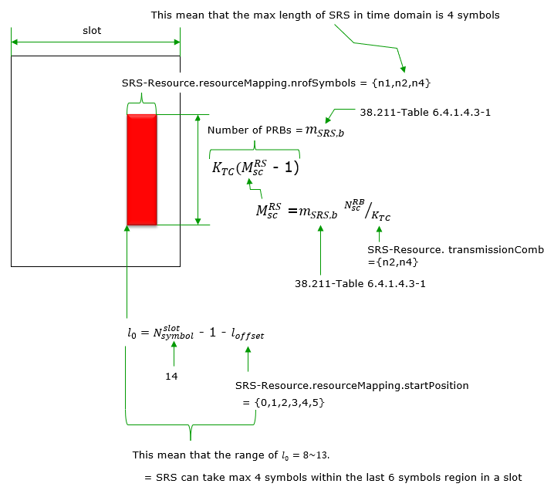
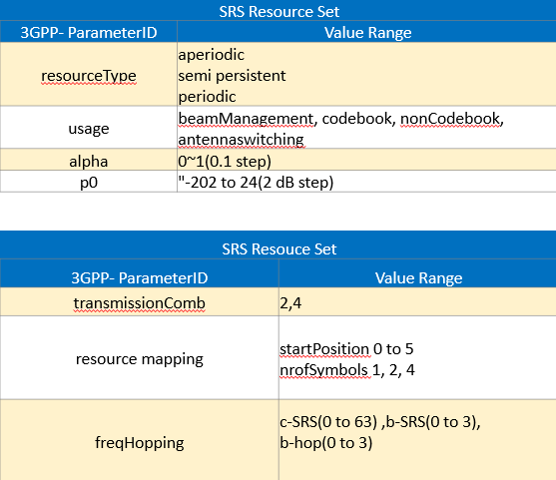

SRS Sequence generation
Note: High subcarrier density (every second subcarrier, many OFDM symbols, and dense period) – will leave less space for multiple UEs.
TS 138 211 6.4.1.4.2 Sequence generation – describes the SRS sequence.
https://www.linkedin.com/pulse/5g-ul-channels-deep-dive-reference-signal-mohamed-eladawi
https://www.sharetechnote.com/html/5G/5G_SRS.html

Slide 10
MATLAB implementation
Here my (MathWorks and ChatGPT) try to implement SRS symbols generation example.
I put comments in the code.
Most of the thing I do understand (I hope ☺).
I assume I got the OFDM modulation – e.g. QAM is modulating all available bandwidth not a single subcarrier ☺ ☺
How to specify carrier frequency [e.g 3.5 GHz]? This I do not get ☹

